Slide 1
A Deep Learning Approach For HandWritten Character Recognition.
A presentation by Morgan Kemp
605 - IT

Slide 2
Introduction
The Question
Can hand-drawn numerical characters be identified by a trained neural network? This is the question that will be answered by this final project. How is this academic? Through the deep analysis of neutral networks showcasing how they function, analysing the various efficiency metrics as well as implementing them to a dataset that can then be trained and visualised through code.
The functionality of the neural network will be analyzed as well as the relationships between parts of the network defined, in order to gain a deeper understanding. Why is this important? This issue can be applied to a wide range of problems that can relate to translation issues. In addition to translation issues, disability issues or learning difficulties can also be considered as part of this issue.

Slide 3
Background of the problem
An accurate character recognition application would be immensely beneficial for a wide range of uses. Creating recognition software can allow users to convert physical pages, signatures, notes, images and other forms of characters into a digital format. With advancements in technology and specifically electronic storage, more data can be held with less space, and once data is converted to digital format, the need for physical copies is diminished. Although there are already products such as page scanners available, they simply copy the image rather than analyse each character to determine its accuracy.
This is a project that uses OCR or optical character recognition to translate text from images into digital content. OCR is mainly used as an alternative to data entry and to gather and analyze information across a variety of industries such as finance, healthcare and research.
By implementing and training AI on a select dataset, it can produce an efficient programme. In this project, additional evaluations will be made regarding the chosen approach and model in relation to the dataset, which will then be visualized through tools and code.

Slide 4
Literature Review
Title | Author | Publication date | Type of Publication | Description and Comparison
Development of English Handwritten Recognition Using Deep Neural Network | Teddy Surya Gunawan, Ahmad Fakhrur Razi Mohd Noor & Mira Kartiwi | 15 April 2018. | Journal Entry | The article talks about how Deep Neural networks are used for handwritten character recognition. This is relevant to my project as the approach is similar, yet the execution and type of neural network differ.
Analysis and comparison of machine learning classifiers and deep neural networks techniques for recognition of Farsi handwritten digits | Y. A. Naneh Karan & Defu Zhang | 28 July 2020. | Journal Entry | This article showcases the use of character recognition software from a medical standpoint, showcasing the benefits of optical character recognition. This use case also uses the same dataset that will be used for this project.
Geological Feature Prediction Using Image-Based Machine Learning | T.D. Jobe, E. Vital-Brazil | DECEMBER 01 2018 | Journal Entry | This journal entry depicts the use case of Petrographic description that geologists use for rock identifications. Although the article focuses on image identification as opposed to character identification, the use case for neural networks and development is the same as well as showcasing relevance to my project.
There is a variety of documentation showcasing how open-source datasets can be trained on neural networks but there is rather limited material on the implementation of the efficiency of neural network analysis in the context of the original question.
Current publications showcase the wide variety of uses of neural networks in conjunction with data-sets to showcase various uses for prediction models and in some cases identification, however, combining the two to create a new programme to identify over 50 '000 unique hand-drawn numerical characters and then evaluate the efficiency of that programme through visual elements is limited.

Slide 5
Proposed Project Plan & Software and Hardware requirements
To assess the performance of Artificial Neural Networks in identifying hand-drawn numerical characters, a visual evaluation will be conducted through the calculation of an efficiency score to gauge the accuracy of the input compared to that generated by the Artificial Neural Networks.
The design layout for the project would be the following:
An introduction showcasing the need for AI
Demonstrate my use case for my Project
Discuss the aims of my project
Discuss chosen dataset
Analyse the functions of the neural network
Implement approach into code
Generate results
Use tools within code to apply visualisation of the efficacy of chosen application method
Evaluate the efficiency of the model by analysis loss and accuracy metrics
A conclusion that discusses accuracy, efficiency, and scalability of approaches to the problem as well as deeper explorations into neural network approaches and data set comparisons.
The hardware and software needed to complete the project can already be found on my personal computer or in university facilities. This project may require the use of PyCharm, Microsoft Visual Studio Code, Google Docs, Google Colab & Microsoft Powerpoint. Libraries relevant to my code are also included in the latest Python 3 versions. As a result of the additional computation power needed in order to train the network, Google Collab will be the primary software used.

Slide 6
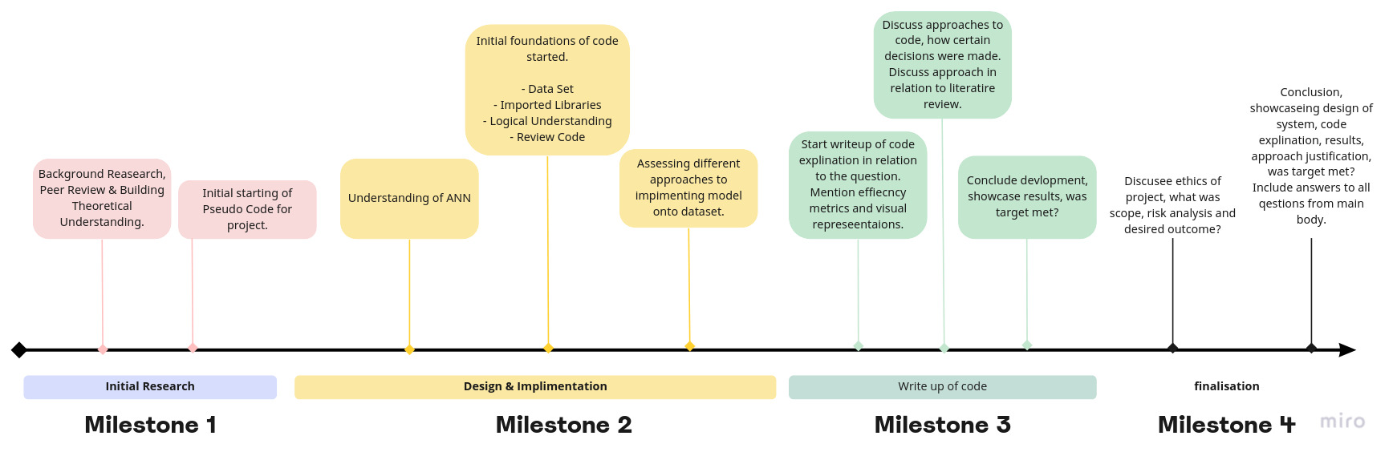
Indicative test plan

Slide 7
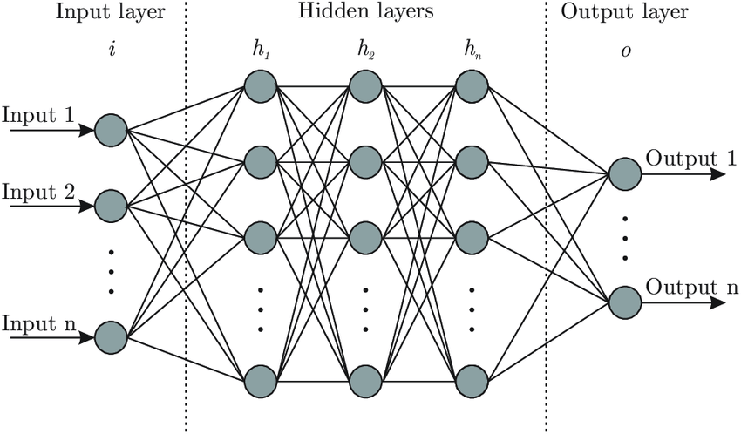
System Design Of The Neural Network
The neural network that will be created follows a standard design principle following a forward propagation design. Factors that must be considered are the efficiency of the model from a computational standpoint, the ability to demonstrate the model in a use case, and finally being able to apply visualisation to the models efficiency.
Figure 1. Example of forward propagation neural network

Slide 8
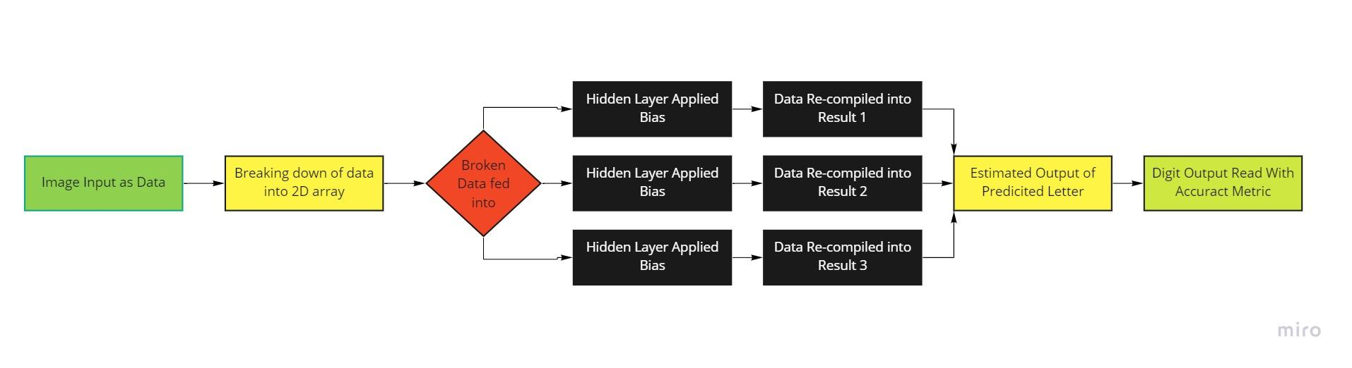
System Design Of The Neural Network
The ERD diagram showcases the functionality of the network that will be created for this project, the diagram shows how data can be fed into the network and then processed through the hidden layers to then generate an output.
To display the efficiency of the model on the trained data, a visualisation tool such as a confusion matrix can be applied.
The model will also be tested through the selections of random data points from the dataset in order to showcase the models functionality.

Slide 9
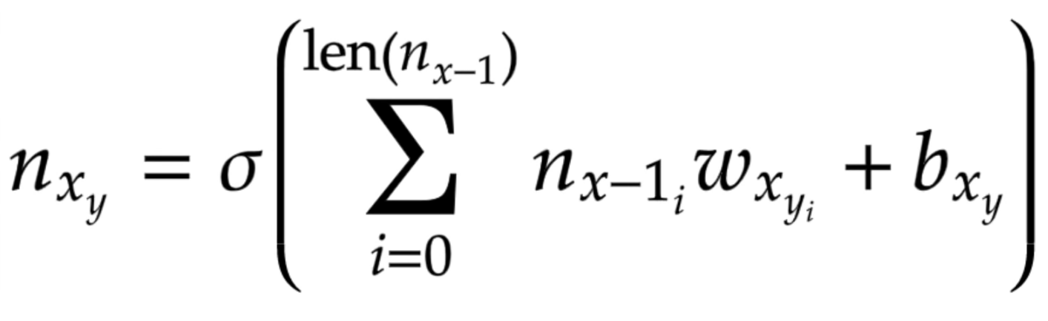
Creating The Network
Following on from the discussed design stages of the previous slides, it is necessary to understand the mathematics behind a neural network so as to create one. For this, a deep dive into the maths behind the functionality of the network was needed.
An easy way to express the function of a neural network is through one simple equation, as shown on the right.

Slide 10
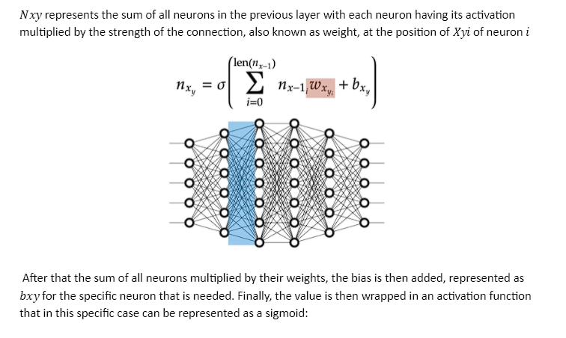
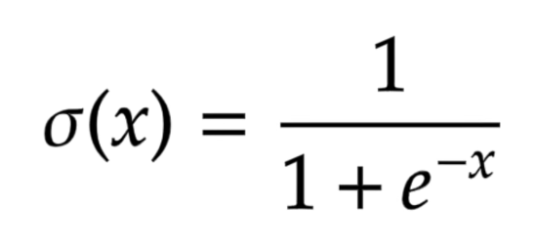
Explanation Of The Maths

Slide 11
Creating The Neural Network In Python

Slide 12
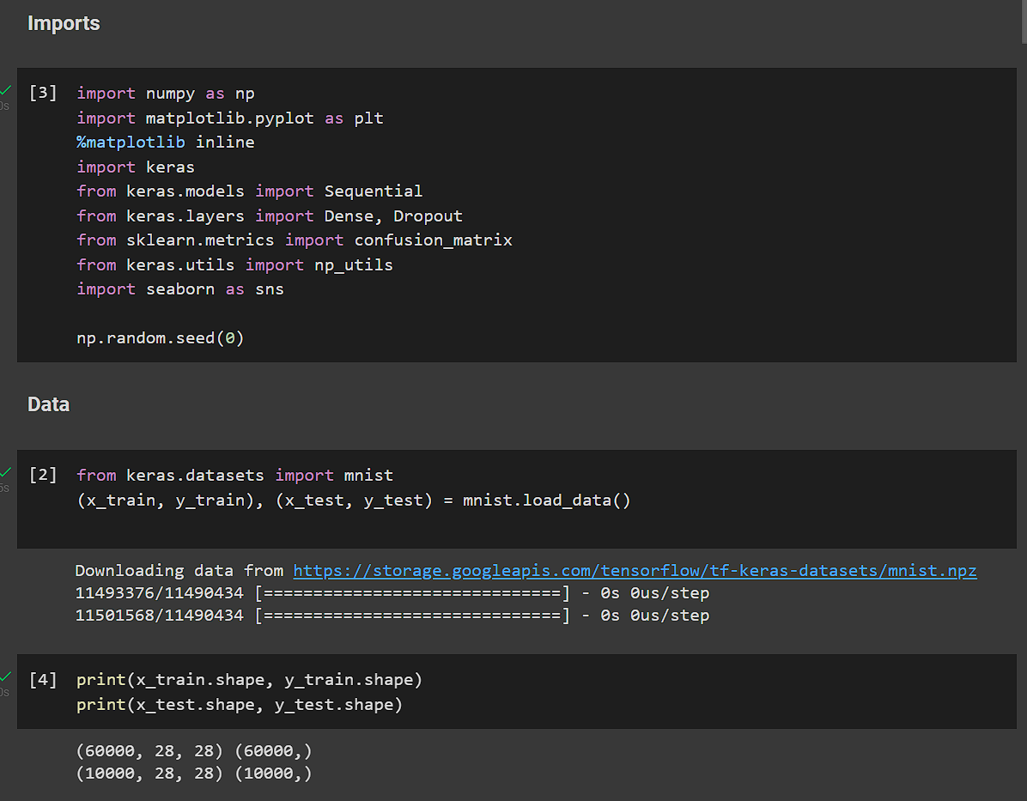
Importing Packages
As mentioned in the previous slides, google collab will be used primarily for the creation of the network due to hardware requirements needed to train the model, as well as having the latest packages installed on a server-side client.
The first step of the creation of the database is to import the necessary packages that will be used.
The print statement at the bottom showcases that the dataset has been imported, as well as showcasing the number of characters within the dataset and how they are represented in a 28x28 pixel image.

Slide 13
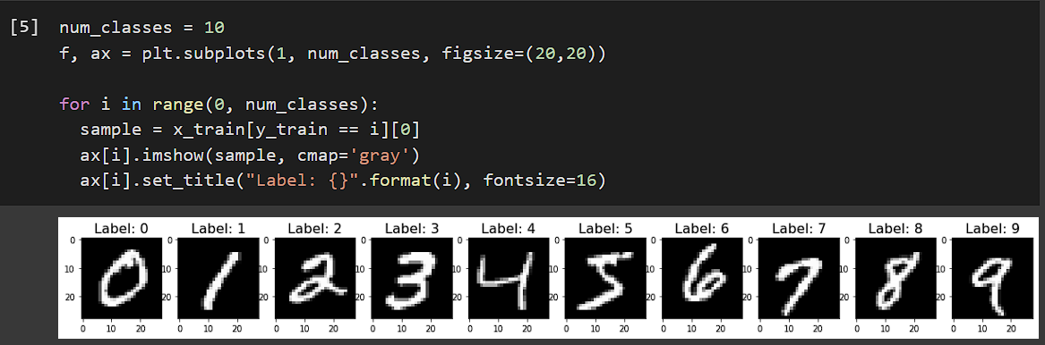
Showcasing the Dataset
Now that the dataset is imported it's best to make sure that it can be represented visually:
This code shows how the sample data is presented in a grayscale format and how the images are labelled. Since the MNIST data set is already balanced, no further classification balancing is required before we can use the data.

Slide 14
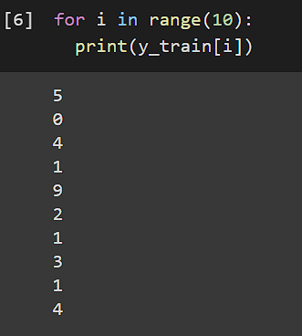
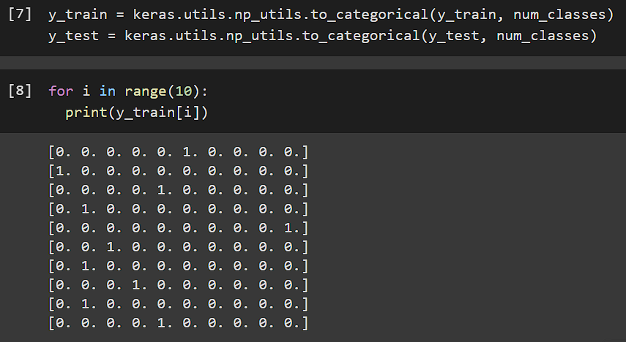
Normalising the data from continuous to classification.
Changing the values of the dataset from a continuous format into a classification based method is essential, as classification identification is the main functionality of the model.
By showcasing the first 10 entries in the data set as single continuous values, changes can be made to convert the continuous data into classification. This is needed because as an example, if an image looks somewhat like a 4 or a 5, the results would fall into the range of either 4.0 or 5.0, whereas the desired output should be a whole number, not an estimate.
The code on the right showcases how the data above can be translated into a vector that is as long as the number within the range, IE 10. The vectors are filled with 0 values aside from the placement of where the number is, meaning that within the vector, each 1 represents the placement of a number.

Slide 15
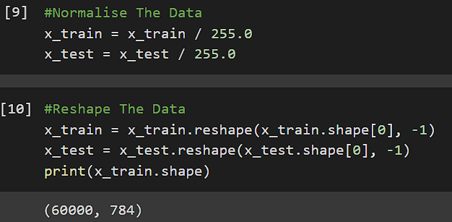
Further Normalising The Data
the next step would be to prepare the entire dataset so that it can be fed into the network as soon as possible. The first step for data preparation is to do normalisation, the reasoning for this is that normalised data has a much easier time being fed through the network in terms of runtime and computational efficiency. This is done primarily by keeping the data within a certain range so that when the training is needed, it is much easier on the network from a computational standpoint.
In the use case of my project, the data is represented in RGB grayscale images containing values of black (represented by the value 0) and white (represented by the value 255) division is needed to keep the range within the classification limits, those being zero and one.
This process transforms the input matrix from a 28 by 28 array into a single long vector that can be passed on to the network, creating a two-dimensional input vector that can handle a large amount of data at once. Instead of having a matrix for each image being a 28 by 28 vector, we now have one long vector containing the sum of the image vectors.

Slide 16
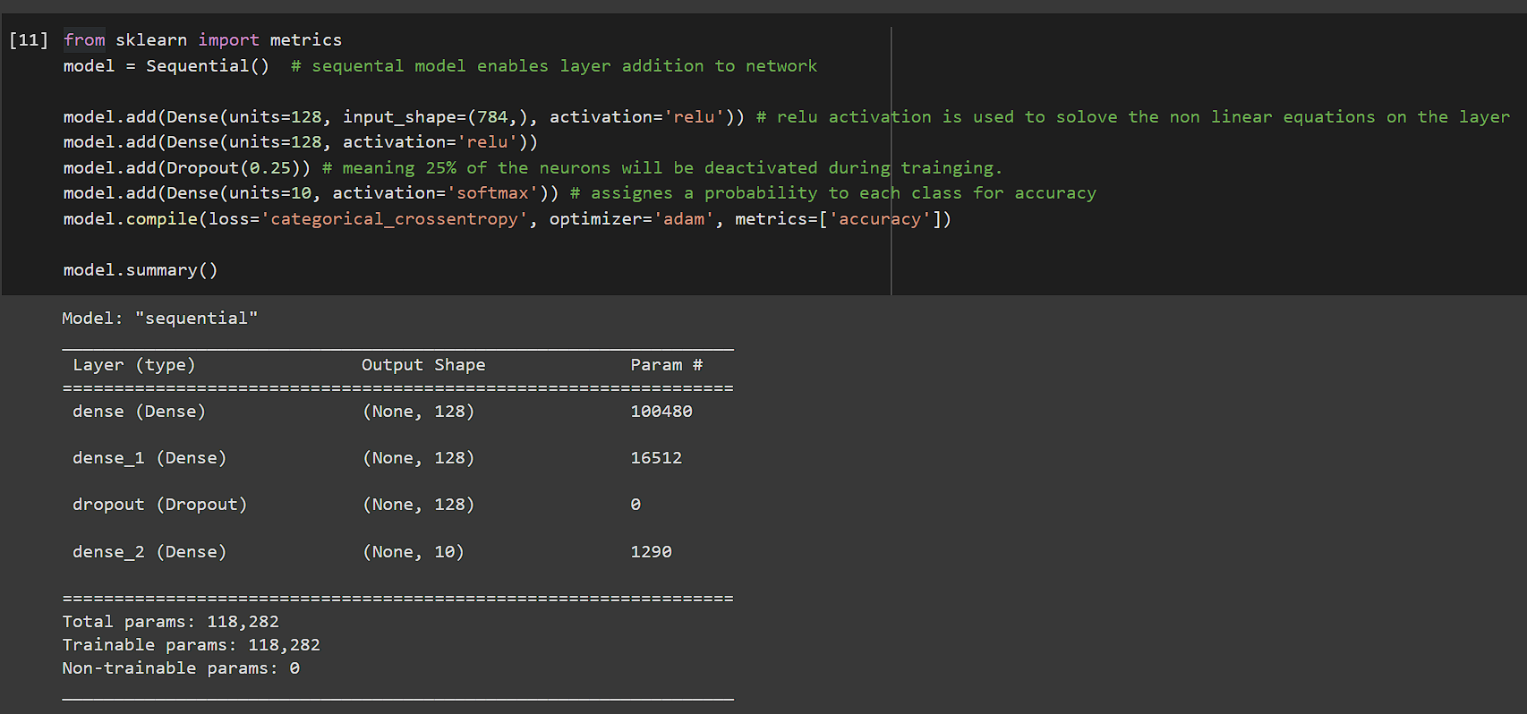
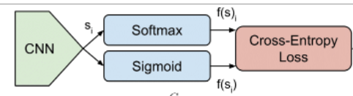
Creating The Neural Network
The network uses a sequential model to enable the creation of additional layers if needed, it also corresponds to an equal amount of input and output layers. Relu activation is used to solve the nonlinear equations on the layer, as well as to convert the weighted summed input to the activation of the node, and softmax is used for our probability distribution function. Adam is used for the optimisation algorithm because it is adaptable to learning rates.
The network consists of three layers and an output layer, two of the 3 layers are dense, a dense layer that is deeply connected with its preceding layer which means the neurons of the layer are connected to every neuron of its preceding layer.
For the network categorical cross-entropy is used for the loss function on our network, it is heavily documented and often used when dealing with a network that handles multiple classes, like the data-set used here. The optimiser is Adam, Adam was chosen as its algorithm efficiency is very effective on our data set due to its adaptability and optimisation when it comes to handling sparse data. Running the model reveals that there are over 100,000 parameters and that they can all be used to train the model.

Slide 17
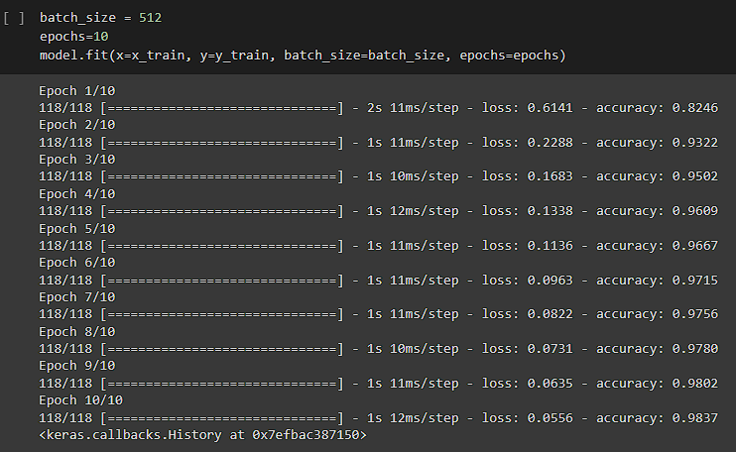
Training The Network on A Small Sample Size
The batch size represents how many images will be imported into the model at one time. The epoch represents cycle of data passing through the network, setting the epoch to 10 is a safe starting number but can be increased if needed.
Apon running the model, it shows that its within the defined epochs limit, but more importantly it shows that as the model is trained the accuracy metrics of the network are increased on each cycle. The loss metric is also decreasing with each cycle.
The combination of both the loss going down and the accuracy going up is a positive sign that the network functions, applying this methodology to a larger epoch should mean that the loss continues to decrease, and the accuracy to continue increasing.

Slide 18
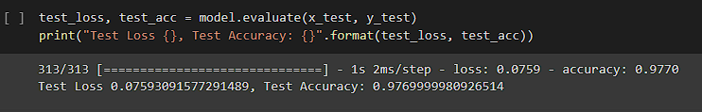
Evaluating The Network
This evaluation showcases the overall test accuracy and test loss of the model on our dataset.
The accuracy metric is what is more important in terms of gathering a overall understanding of efficiency on the model.
The next step will be how we can use this model on classification prediction on some input images.

Slide 19
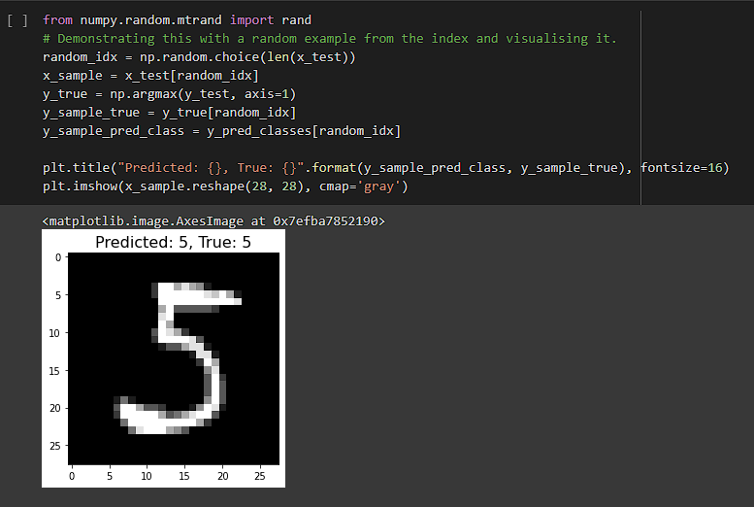
Demonstrating This On A Random Datapoint
Using NumPy random, a selection of a random image from the data set was chosen and applied to the trained model. Visual tools were used to demonstrate the prediction that the model came up with in comparison to the true value of the image.
This example showcases repeatability as this section of code can be run again and again to showcase a different point within the dataset.

Slide 20
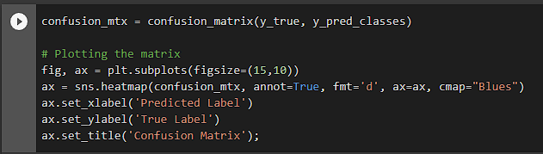
Creating A Confusion Matrix For Classification Accuracy
Throughout the design and implementation of the model various visual tools were considered for showcasing the overall accuracy of the model, how the model handles results differently or if there are any hidden biases. For the final representation the confusion matrices was chosen as the pinnacle summary tool.
A confusion matrix will assess the accuracy of the model against various classifications visually. This helps in terms of identifying if the network is handling certain classifications differently.

Slide 21
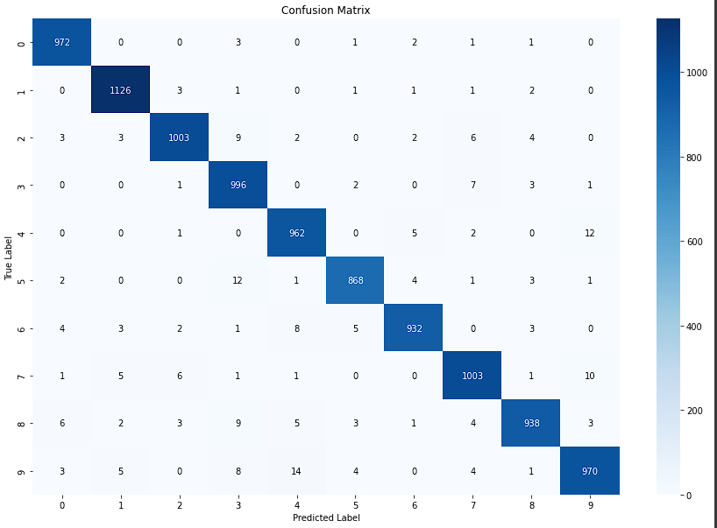
Confusion Matrix

Slide 22
Evaluation of a Confusion Matrix
A confusion matrix was chosen due to it fitting the initial problem of classification identification. A confusion matrix works by showcasing the number of correct and incorrect predictions are summarized with count values and broken down by each class.
The confusion matrix represents all of the classes for the digest in the dataset. On the left side are the 'True Labels' and on the bottom are the 'Predicted Labels'. The efficiency of the model is represented by the number of true labels predicted against the total number of images for each number. Looking at 0 as an example, for every 0 that has a true label of 0 (meaning that it is indeed an image of 0) the model predicted 972 total zeros, meaning that the model is rather accurate in terms of identifying the classification of zeros. From this information the matrix shows that the model also predicted some numbers to differ from its true value, an example of this is that the model predicted one image of the number 3 to be a 1. Comparing this again with another number, for example 4, the model predicted a total number of 962 fours to be accurate to their true number, and 8 fours to look like nines. The confusion matrix is the most effective method for analysing how accuracy the model is in terms of classification identification in a visual format.

Slide 23
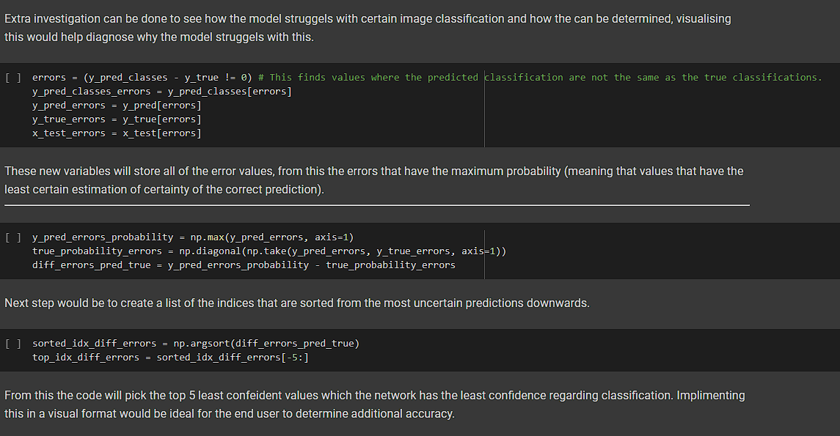
Error Investigation

Slide 24
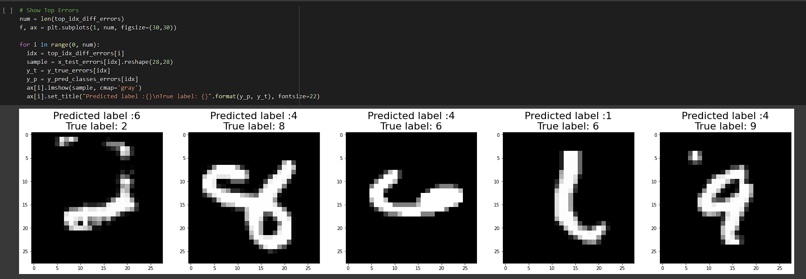
Error Investigation Visualised
As shown in the funcion above, once ran the functions showcases the 5 most uncertain predictions from the model and compares the estimation against the true value, this will also correspond with earlier code from the confusion matrix.

Slide 25
Evaluation Of The Work, Critical Reflection & Concluding Remarks.

Slide 26
Was The Project a Success?
The overall project was a success, the creation of a fully functional neural network that can successfully identify hand written numerical characters through classification identification is complete.
Visualisation of the efficiency of the model that was trained has been completed, showcasing effective metrics in terms of accuracy, loss and error investigation.
The following objective have been met:
Creation of a neural network using TensorFlow and Keras
The neural network is able to detect handwritten characters
There is an explanation walkthrough of the logic behind the neural network as well as code
Efficiency metrics that can evaluate the model's efficiency visually have been created

Slide 27
Critical Reflection
Approaches to the problem were covered and compared, IE the discussion of forwarding propagation, how loss over accuracy metrics can define the accuracy of the model as well as testing the model on a random datapoint within the dataset to showcase its usage. Explanation of a mathematical approach to the problem and showcasing explanation of functions through equations were also demonstrated.
Factors that were mentioned in the report such as using google collab for the computations on google's server side hardware for the training of the model were a success.
An example use case for this project is a speed camera using a system that uses a neural network similar to the one used in this project to recognize the characters on a wide variety of number plates, despite blurring or inaccurate images from the dataset.
Upon reflection on the project, the development of the model and implementation of the visualisation of efficiency was the biggest hurdle, requiring the most time to understand various methods of efficiency evaluation and then implementing that into code.
The chosen dataset was beneficial due to factors that were pre-defined before it was used from code, IE being normalised and balanced before import making the handling of the data with TensorFlow streamlined. Implementation of packages such as Keras was also streamlined compared to personal machines where there can be compatibility errors.

Slide 28
Professional Issues
A summary of the professional issues of the project could be that neural networks as a whole require large amounts of data, therefore depending on the problem at hand, there can be issues in development and applications, maybe a neural network is not needed/is redundant. Additionally, biases and metrics to diagnose the effectiveness of a neural network require a deep understanding and sometimes without proper compilation of the network could make it that the network is unfair and biased.
Ethical issues need to be considered in conjunction with professional issues. Making sure steps are taken to make sure the data that is used adhered to internal and external standards, international standards such as ISO 27000 / 27001, as well as complying with legal legislation such as GDPR. Making sure the usage of the neural network would be for non malicious or bias practices that could affect individuals.

Slide 29
Concluding Remarks
To conclude, this project was a success, the creation of a neural network was completed and fully functional using the MNIST dataset. Applications of visualisation tools for efficiency and accuracy metrics were generated also. The original development pipeline adhered to as well as plentiful documentation throughout the development process providing additional explanation and discussion into the chosen methods.

Slide 30
Supervisor Meeting Log Table
Supervisor | Date | Summary
Dr Caxton | 29/03/22 1 pm-1:30 pm | Showcased work so far, demonstrated my model, talked about the need for being able to demonstrate functionality to non technically adverse individuals.
Dr Nadeem Qazi | 30/03/22 9:30 am - 10:30 am | Walkthrough of my work to Nadeem, showcasing network, showcasing functions and equations, showcasing explanation of layers and inputs/output.
Dr Caxton | 05/04/22 14:45 pm - 15:16 pm | Covered brief overview of ass 2, looking at explanation, covering labels of images and figures. Talked about the universal application of the model to different use cases and datasets, IE traffic lights and speed cameras.
Dr Nadeem Qazi | 06/04/22 11:00 am - 11:40 am | Explanation of code in prep for the viva, walkthrough of some additional information in report and discussion of moving some criteria to critical reflection/appendix.
Dr Caxton | 12/04.22 10:20 am - 11:05 am | Talking about final project submission, recording of project explanation and career aspirations.
Dr Nadeem Qazi | 13/04/22 10:30 am - 10:50 am | Told Nadeem that i’m fine with my work, we agreed to rearrange for a viva later on today. (Had Viva @ 13:45, happy with outcome.

